Slide 1
SYSTEMS ANALYSIS AND
DESIGN
INTRODUCTION

Slide 2

Systems Analysis and Design is the process people use to create (automated) information systems
Systems
Analysis
& Design
Information
System

Slide 3
Systems Analyst
A title given to a person who studies the problems and needs of an organization looking for improvement opportunities.
Other names:
Software Engineer
Systems Engineer
Software Developer
Programmer/Analyst

Slide 4





SYSTEMS ANALYSIS AND DESIGN: A Condensed (Informal) Perspective
An idea
Analysis
Design and
Implementation
Completed
Information
System
Time

Slide 5
System Types
Abstract
Physical
Open
(Interact with
Environment)
Closed
(Do not
Interact
With
Environment)
Man made
Information
Systems
Conceptual
Dynamic
Static
MIS
Physical parts
Of a C.C, Office,
Desk/Chairs
(Can be seen &
Counted)
Formulas or
Models
Data, Programs,
Output Application
DSS
Business
Systems

Slide 6
Business “problems” come in all sizes and shapes!
Name & Address Book
CD Collection
Course Registration
Reservations
Student Grades
Payroll
ATM machine & Banking in General
Check-Out Counters at Retail Stores
Order Fulfillment - Mail or Web Ordering
Manufacturing
Securities Portfolio Management
Space Shuttle Flight
Election Results
Video Games (Arcade and Home)
Examples:

Slide 7
System
A SYSTEM is a set of:
      interrelated components
      working together
      for a common purpose

Slide 8
A Generic System Model
(with Six Components)
SYSTEM
processing
boundary
controls
inputs
feedback
outputs
Examples:
Automobile
Student Registration System
Others...

Slide 9
Systems Analysis and Design is the process people use to create (automated) information systems
data
people
SA&D
software
procedures
hardware

Slide 10
The people who do SYSTEMS ANALYSIS and DESIGN produce information systems that are:
  used internally within the organization
  sold commercially via mail/web order or retail store
  imbedded in products

Slide 11
Systems Analyst’s interactions with people during Systems Analysis & Design
Steering
Committee*
Users*
Managers*
SYSTEMS
ANALYST
Vendors
Database
Administrators
Programmers
& Tech. Staff
Systems Analyst
may be acting as
a Project Manager
for some of these
interactions.
* = Stakeholders

Slide 12
What does a Systems Analyst do?
Studies the problems and needs of an organization looking for improvement opportunities for:
      increasing revenue/profit
      decreasing costs
      improving quality of service

Slide 13
What is a Systems Analyst responsible for?
Effective and efficient:
      CAPTURE of input data
      PROCESSING & STORAGE of data
      DELIVERY of timely and accurate information

Slide 14
Sequential or Traditional SDLC
“Begin”
“End”
1. Planning for an information system
2. Feasibility Study (optional)
3. Requirements Determination (gathering)
4. Conceptual design
5. Physical design and/or purchase and/or prototyping
6. Conversion from current system to new/changed system
7. Training
8. Implementation
9. Evolution for enhancements and maintenance
Waterfall or Staircase SDLC
Planning
“Begin”
“End”
Feasibility Study
Requirements Determination
Conceptual Design
Physical Design
Conversion
Training
Implementation
Evolution

Slide 15
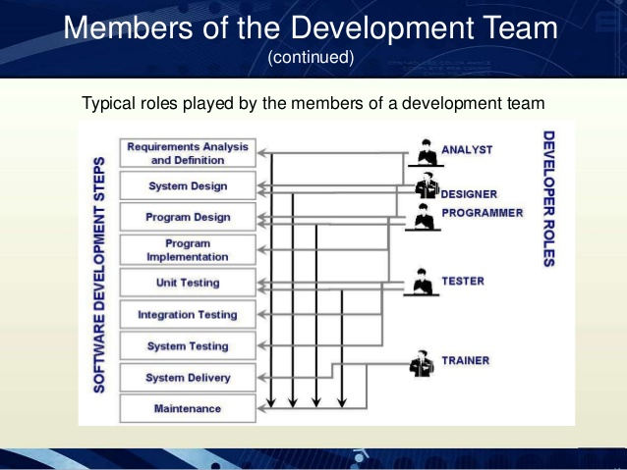

Slide 16
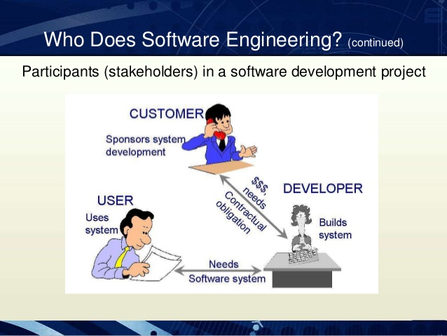
Pay salary
Provide info

Slide 17
